Slide 1
eCall and ERA-GLONASS interoperability: Work of 2017-2018
Risto Öörni, VTT
Mikko Tarkiainen, VTT
Henri Sintonen, VTT
Aleksey Golovteev, JSC GLONASS
Transport Week, Moscow, 21st November 2018

Slide 2
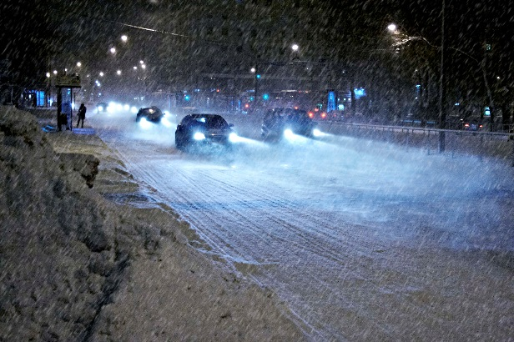
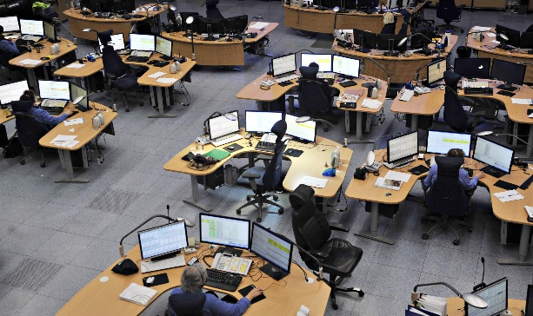
Contents
Motivation
Differences between eCall and ERA GLONASS
Test objectives
Test arrangements
The first results and identified problems
The next steps
Photo: VTT
Photo: www.112.fi

Slide 3
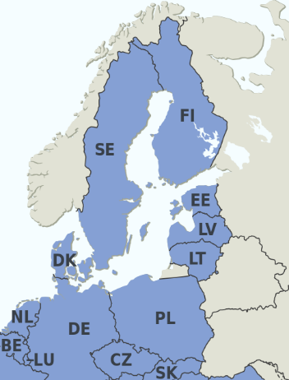
eCall and ERA-GLONASS
 | eCall | ERA-GLONASS
Region | EU | Russia + Belarus + Kazakhstan
Vehicle categories | M1 and N1 | All categories (M1…M3, N1…N3)
NO
RUS
Vehicles registered in
ERA-GLONASS system:
2 750 797
https://aoglonass.ru/en/gais-ehra-glonass/ (cited 31.10.2018)
BY
Source: https://commons.wikimedia.org/wiki/File:EU_Member_states_and_Candidate_countries_map.svg

Slide 4
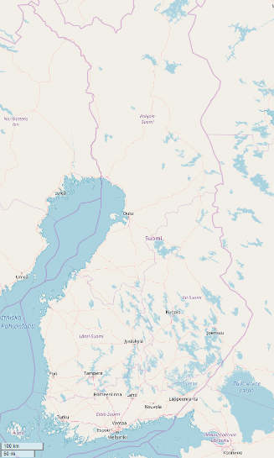
Motivation
Russian ERA GLONASS and pan-European eCall are harmonised but not identical
It is important to ensure and test system interoperability
Target is to provide service coverage for European vehicles in Russia and Russian vehicles in the EU
At the moment, there is no agreement between EU countries and Russia on handling of emergency calls from vehicles
FI / RUS
Border length
1340 km
2M vehicles
2M vehicles
© OpenStreetMap contributors

Slide 5
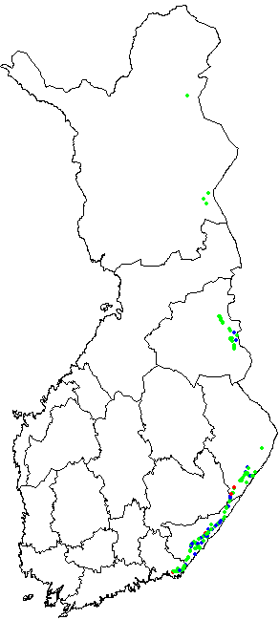
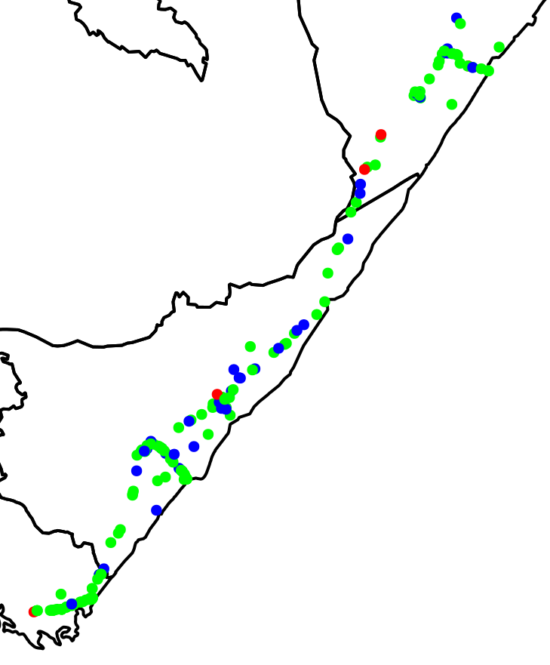
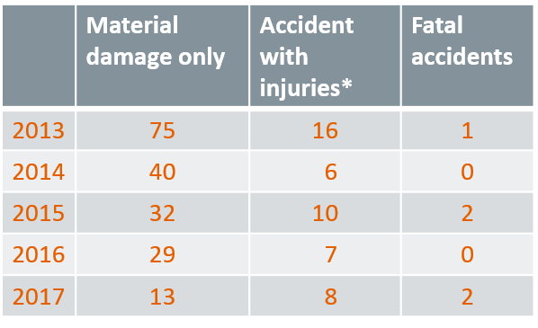
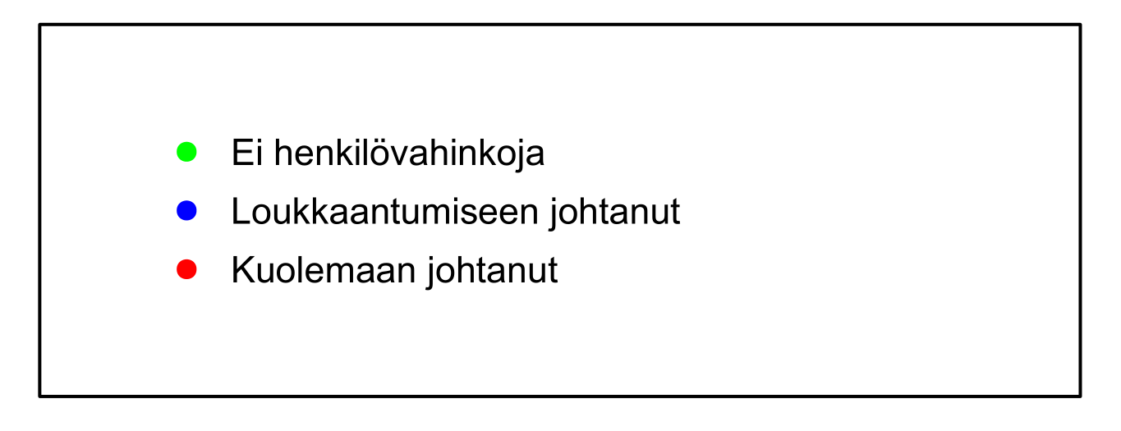
Road accidents near Finnish-Russian border
Road accidents in Finland,
< 20 km from border and involving a Russian citizen
* Fatal accidents not included in the number of injury accidents
No injuries
Accident with injuries
Fatal accident

Slide 6


eCall system in Finland
MSD
Emergency
response
services
2G/3G
PSAP
eCall IVS
ERA-GLONASS system
MSD
MSD
Emergency
response
services
2G/3G
ERA-GLONASS
operator
(filtering contact
centre)
System-112
(PSAP)
ERA-GLONASS IVS

Slide 7
eCall and ERA-GLONASS Comparison
(related to interoperability)
 | eCall | ERA GLONASS
GNSS | GPS + (GALILEO) | GLONASS + (GPS or GALILEO)
Emergency number | 112 | 112
MSD data transfer | In-band modem | In-band modem + SMS backup
MSD | EN15722 (version 2) | EN15722 (version 1 & version 2)
SIM card | SIM card from ? | ERA GLONASS full Mobile Virtual Network Operator SIM card
Emergency call features | Voice call, MSD (re)transmission, call back, … | Voice call, MSD (re)transmission, call back, …
Additional features | Network-based positioning, similar to other emergency calls in the EU (EN16072, Universal Service Directive) | Base for public Services and a variety of consumer Value Added Services

Slide 8


MSD versions
Interoperability issue with MSD versions?
  eCall supports MSD version 2 (EN15722:2015)
  Specifications of ERA-GLONASS allow use of MSD version 1 (EN15722:2011) in IVS until January 2018
  ERA GLONASS (PSAP) supports both versions and
  OEMs in Russia today use MSD version 1 and only gradually may start moving to version 2
    I_HeERO (*) countries have implemented eCall in PSAPs with equipment which supports both MSD versions 1 & 2, including Finland
    => No problem with this issue!
* I_HeERO: Harmonised eCall European Deployment, http://iheero.eu
Photo: www.112.fi

Slide 9


Interoperability tests of eCall and ERA-GLONASS
TEST OBJECTIVES: interoperability tests focused on the core features of both systems:
    Transmission, decoding and presenting of minimum set of data (MSD)
    Voice connection between user of the IVS and PSAP
    MSD retransmission
    Call back from PSAP to IVS
A specification has been created for interoperability testing
Tests in Finland and Russia have been planned and implemented in cooperation with
    Ministry of Transport of Russian Federation
    JSC GLONASS, which operates the GAIS ERA-GLONASS system
    Ministry of Transport and Communications (Finland)
    Finnish Transport Safety Agency (Trafi)
    VTT Technical Research Centre of Finland Ltd
    Emergency Response Centre Agency (Finland)
    (Supported by *I_HeERO project)
*I_HeERO project was funded under the Connected Europe Fund Annual Programme Grant agreement no. 1031743

Slide 10
Qn | Interoperable features statement questions | Interop. exp. | Notes
Q1 | eCall flag, emergency call routing to PSAP
Q2 | MSD transmission to PSAP |  | (see MSD versions 1 & 2)
Q3 | MSD decoding & visualisation |  | (see MSD versions 1 & 2)
Q4 | Establish voice connection
Q5 | Call cleardown by PSAP by hanging up
Q6 | Call cleardown by PSAP by in-band modem
Q7 | Request retransmission of MSD by SMS | - | Not supported in eCall
Q8 | Request retransmission of MSD by in-band-modem |  | (SMS is used in ERA GLONASS)
Q9 | Call back from PSAP to IVS |  | Not possible if no roaming SIM
Q10 | Request retransmission of MSD (in-band modem) during call back |  | (SMS used in ERA-GLONASS), No if not roaming SIM
Q11 | Request retransmission of MSD by SMS during call back | - | Not supported in eCall
Q12 | Mobile network based positioning of the caller | - | Not in ERA GLONASS
Q13 | Mobile network provides IVS CLI to PSAP |  | Not possible if no roaming SIM
See summary of the test plan: I_HeERO M21

Slide 11
Use case 1: eCall IVS in Russia contacting ERA-GLONASS system
Points of observation
& stimulus
MSD
MSD
2G/3G
ERA GLONASS
operator
(filtering contact
centre)
System-112
(PSAP)
eCall IVS
MNOs: MTS, Megafon, VimpelCom
IVS: Gemalto eCall Test Box
SIM: Elisa, Telia
Use case 2: ERA-GLONASS IVS in Finland contacting eCall PSAP
MSD
IVS: Fort Telecom 112 EG
SIM: JSC GLONASS
2G/3G
PSAP
ERA GLONASS IVS
MNOs: Telia, Elisa, DNA

Slide 12


Positive results
Successful transfer of MSD version 2 and two-way voice communication from eCall IVS in Russia with the Filtering Contact Center of ERA-GLONASS and the System-112 Center, using the networks of MTS and MegaFon.
The MSD sent by an ERA-GLONASS IVS was successfully decoded in Finland by an eCall PSAP, this was verified for both MSD versions 1 and 2.
Successful two-way voice communication between ERA-GLONASS IVS and Finnish PSAP.

Slide 13
Work to advance interoperability is going on
In Finland, the transmission of MSD from IVS equipped with foreign SIM card was successful but the presentation of the information in the PSAP was not.
  Problem identified and a fix is being tested!
Call back from an eCall PSAP to ERA-GLONASS IVS was not possible in Finland due to lack of roaming agreements.
Russian PSAP was not able to request a retransmission of MSD from the eCall IVS equipped with a foreign SIM card, possibly due to lack of roaming agreement in Russia
MNO VimpelCom did not route emergency calls to ERA-GLONASS system from an eCall IVS with a Finnish SIM card.
→ The issue is being worked on
Call back to eCall IVS in Russia was only possible as a normal phone call (no MSD retransmission during call back).
Near the border: If the IVS is located in the territory of a foreign country, but registered to a network of its home country, the emergency call and the MSD are sent to the PSAP of the home country and emergency assistance is currently difficult
→ MSD information sharing required

Slide 14
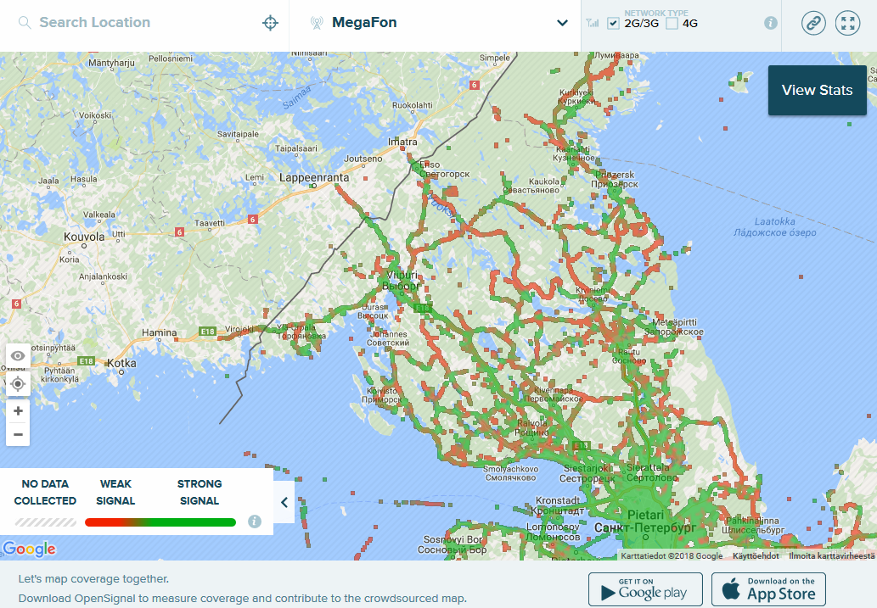
Topics for further research
  Interoperability will remain as a research topic in the future:
  NG eCall
  eCall for heavy goods vehicles
Emergency calls from vehicles in cross-border situations:
  E.g. ERA-GLONASS emergency call in territory of Finland when the IVS still connected to Russian mobile network
  → (MSD) information exchange needed
Source: https://opensignal.com/

Slide 15
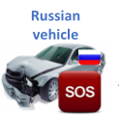
A potential model for MSD information sharing between Finland and Russia
PSAP (Finland)
Gateway (Finland)
Gateway (Russia)
ERA-GLONASS
4.
6.
5.
MSD Database
3.
Russian vehicle with ERA-GLONASS
7.
Russian base station
2.
Finnish Emergency Service
1.
Russian MNO

Slide 16


Plan for the first tests of MSD information sharing between Finland and Russia
2.
1.
PSAP test environment (Finland)
VTT SIP server
Gateway (Russia)
ERA-GLONASS
4.
3.
MSD Database
Gateway (Finland)
Finnish Emergency Service
Russian MNO

Slide 17
Thank you!
Contact:
Risto.Oorni@vtt.fi

